Slide 1

Best Time to fly
Presented by Angie Oehler

Slide 2


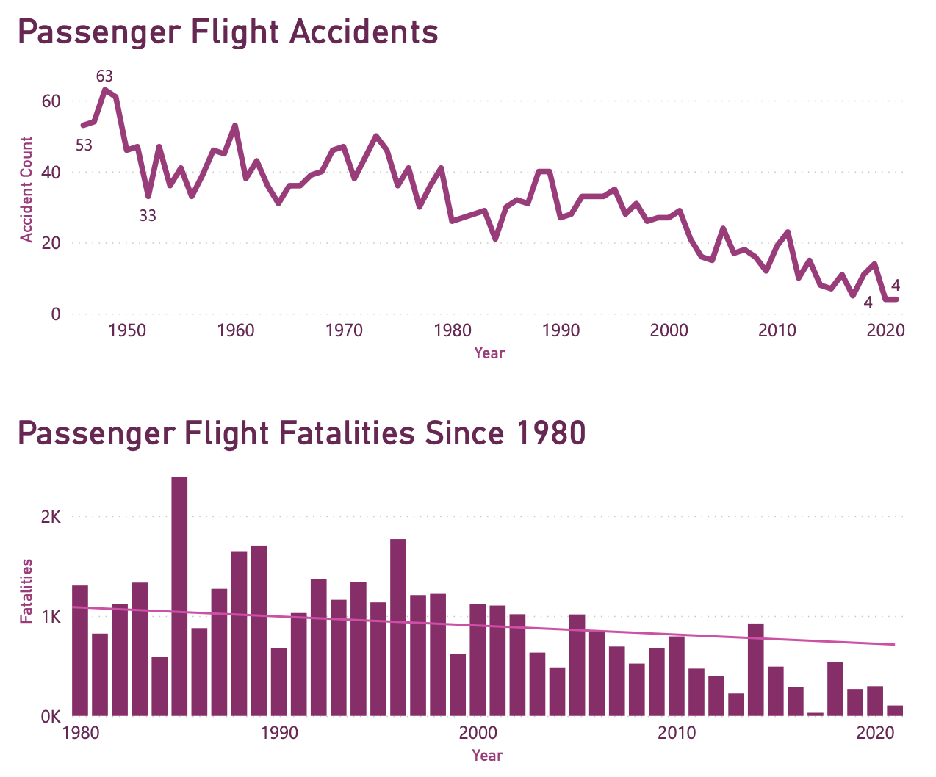
Safest time to fly
Decrease in accidents
Decrease in fatalities

Slide 3
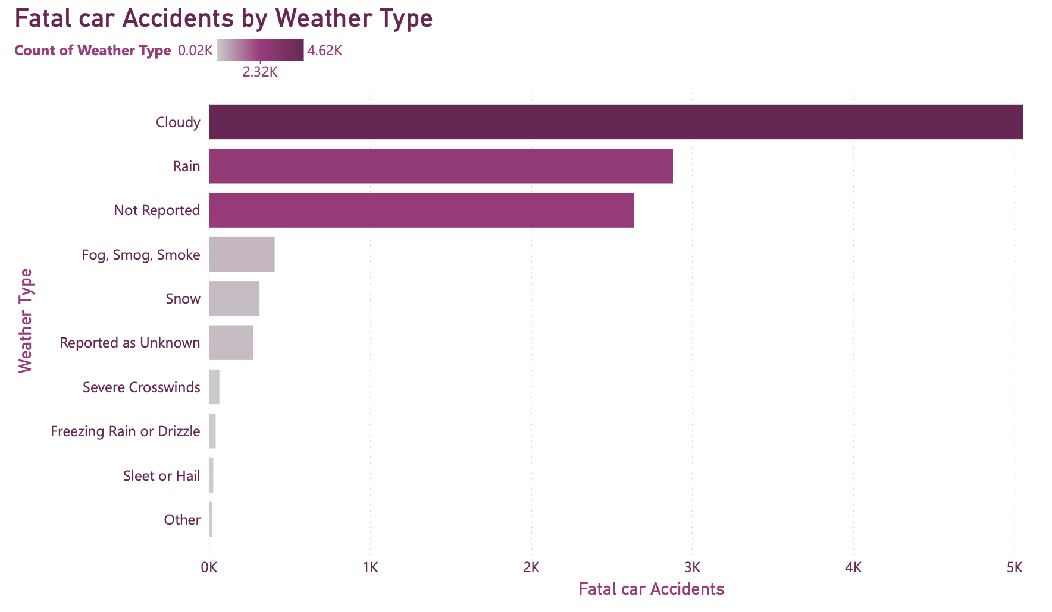
Flying Safer than driving
Old saying , but true
Dangers of driving

Slide 4

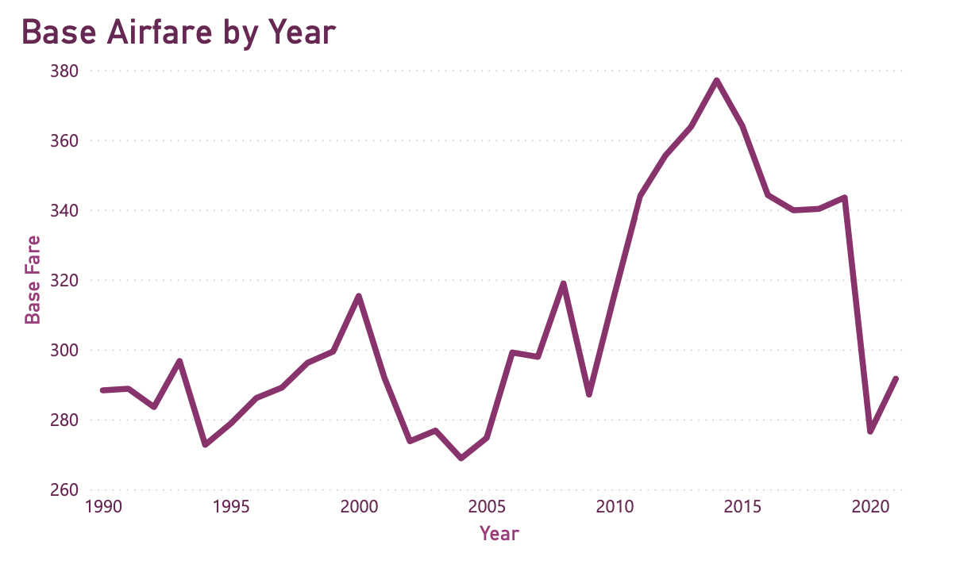
Cheapest time to fly
Decrease in airfares

Slide 5
Thank you!
Best time to fly
Safer than ever!
Safer Alternative!
Cheaper than Ever!

